Slide 1

Parameterize Pipelines in Azure Data Factory
Chi Zhang
New Star of Data | Oct 4th 2022

Slide 2

Lead Data Architect at 3Cloud, a Microsoft gold partner consulting firm that provides clients with the ultimate Azure experience by delivering Infrastructure, data, Agile Software solutions and more within Microsoft’s eco system .
Had about 5 years of experience in the Azure data world, worked on various projects for clients from different industries such as manufacturing, education, retail, finance and insurance.
Started out working on custom Power BI development projects and then moved upstream to data warehousing, and ELT jobs in Synapse, Databricks, Azure Data Factory and more.

Slide 3
Content
Basic ADF pipeline components
Parameters in ADF pipelines
Control System for pipeline orchestration Walkthrough

Slide 4
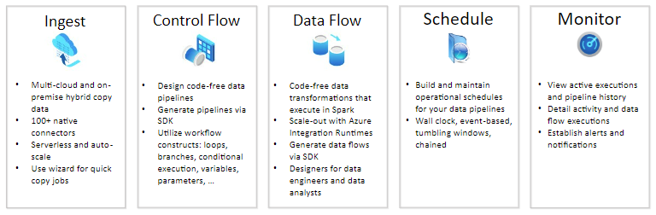
Azure Data Factory
Code-Free ETL as a service
Orchestration Tool
Notes:
Daily hearing about Big Data, they can be raw, unorganized that’s stored in relational, nonrelational and maybe other storage systems. They don’t provide value in their raw form. it requires a service that can orchestrate and operationalize processes to refine the raw data into actionable business insights. Azure Data Factory V1 came out in Aug 2015, v2 came out in Sept 2017. It is the cloud-based ETL and data integration service that allows you to create data-driven workflows for orchestrating data movement and transforming data at scale.

Slide 5
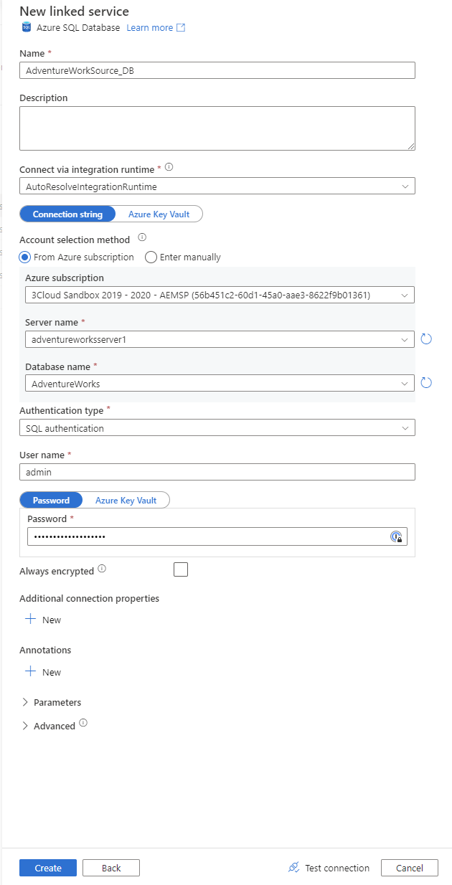
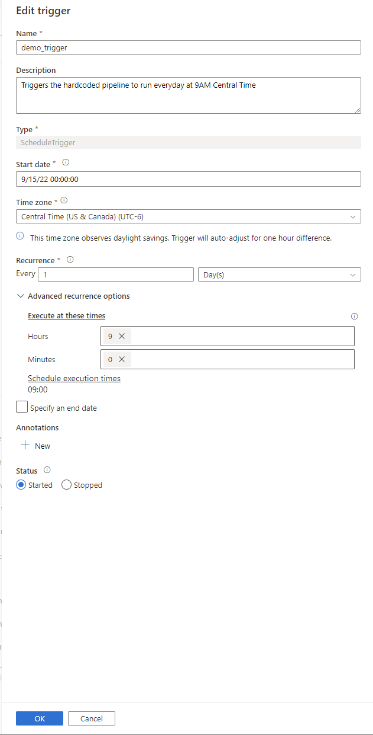
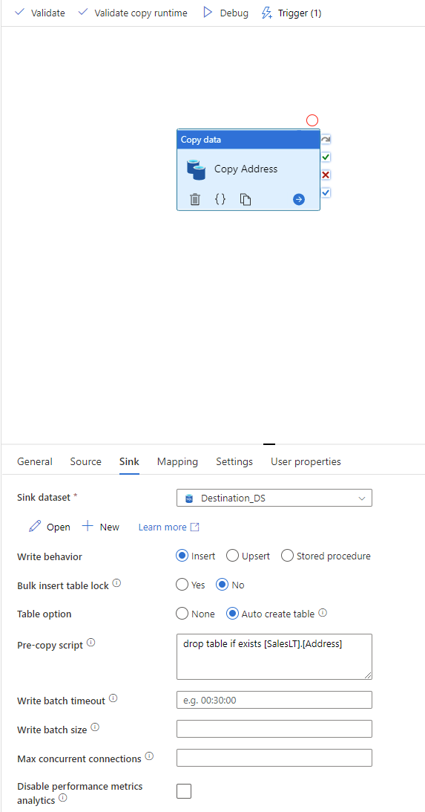
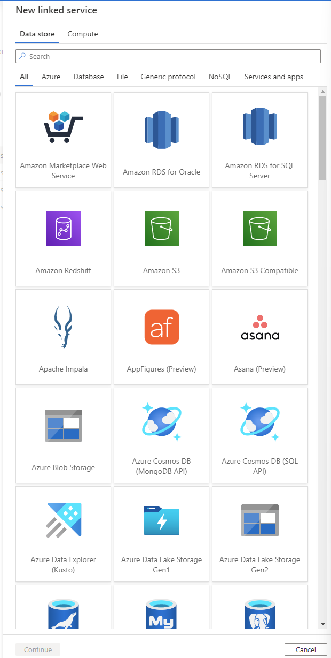
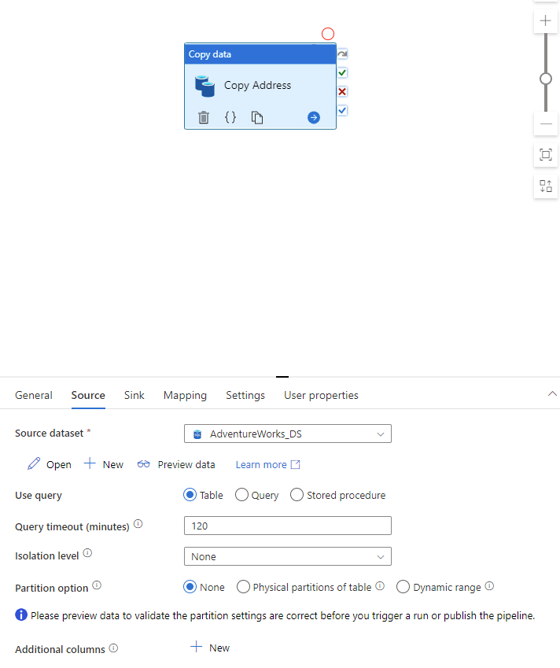
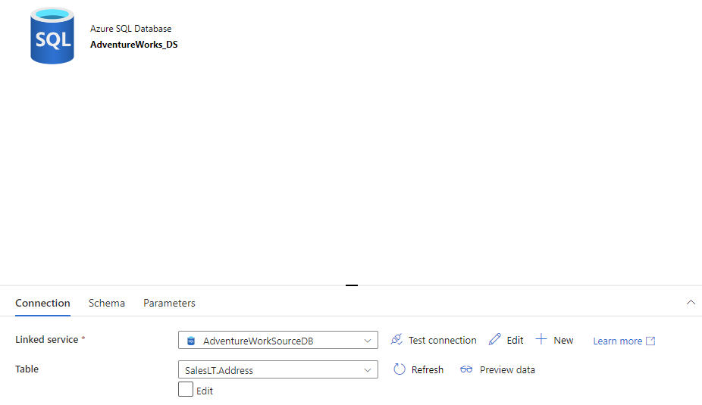
To build a pipeline
Create Linked Services
Create Data Sets
Create Pipeline
Create Activities inside pipeline
Test
Set Trigger

Slide 6
What if there are 1000 objects to move from the same source?

Slide 7
Create 1000 Hardcoded pipelines?

Slide 8
Problems: Manual work will take a LONG time Maintenance nightmare on updates and fixes

Slide 9
Introducing Parameters

Slide 10
Parameters
Parameters are key – value pairs that are defined in the pipeline.
The values provided to the parameters at trigger are passed to the pipeline during execution.
They can be used in Linked Services, Datasets and Pipelines ( and Data Flow).
User
Pipeline
Activity
Dataset
Linked Service
Trigger

Slide 11
Parameters Examples
@pipeline().parameters.parameterName
@dataset().ParameterName
@linkedService().ParameterName
System Variables :
@pipeline().RunId, @pipeline().TriggerName
ForEach Activity Sub Parameters:
@item().ParameterName (results from the ForEach activity)

Slide 12
Expressions and Functions
Expressions start with the @ symbol.
At runtime, the expression is evaluated and replaced with the literal string value.
Functions can be part of the expressions. They include:
String, Date, Collection, Logical, Conversion and Math Functions

Slide 13
Expressions and Functions
Examples for expression:
@concat('SELECT ‘, item().WatermarkColumn,
' FROM ',item().SchemaName,'.’,
item().TableName,' ORDER BY ‘, item().WatermarkColumn,' DESC’)
@activity('Get Max Watermark from Source').output.firstRow[item().WatermarkColumn]

Slide 14
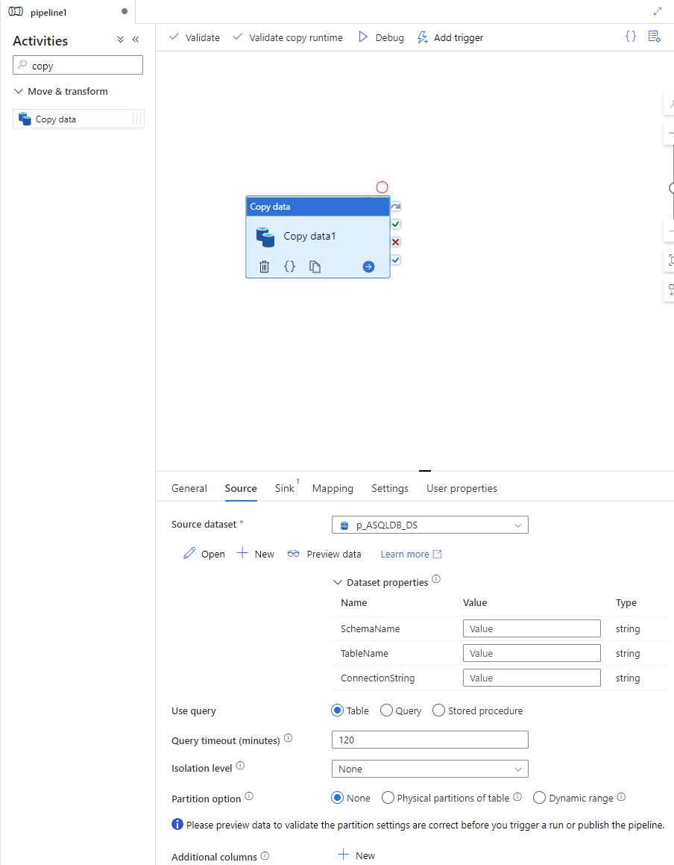
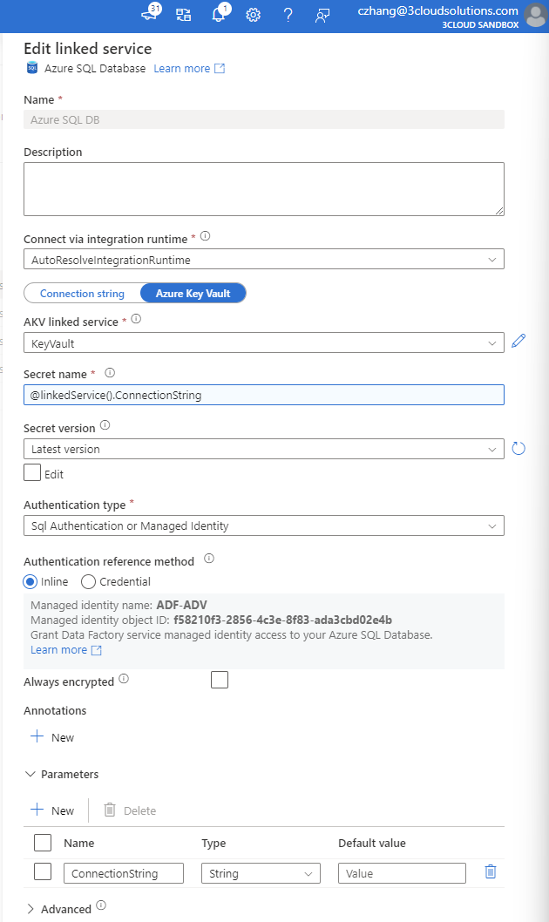
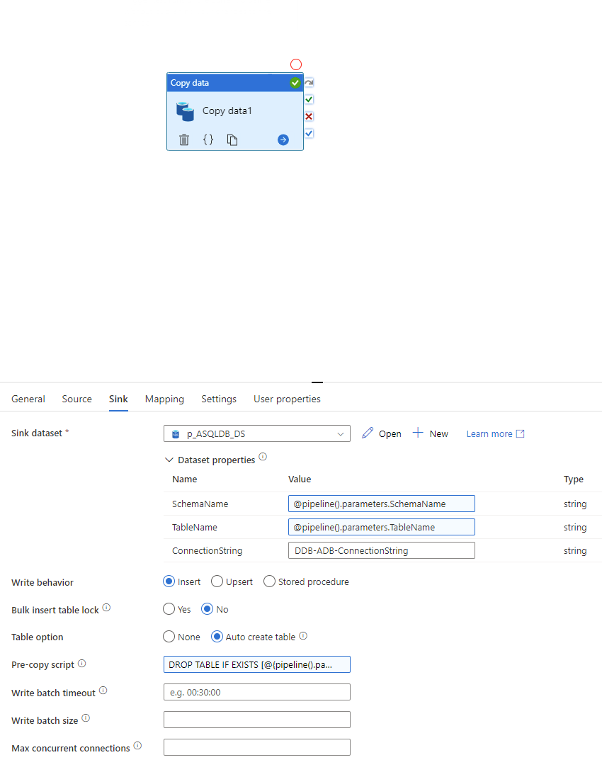
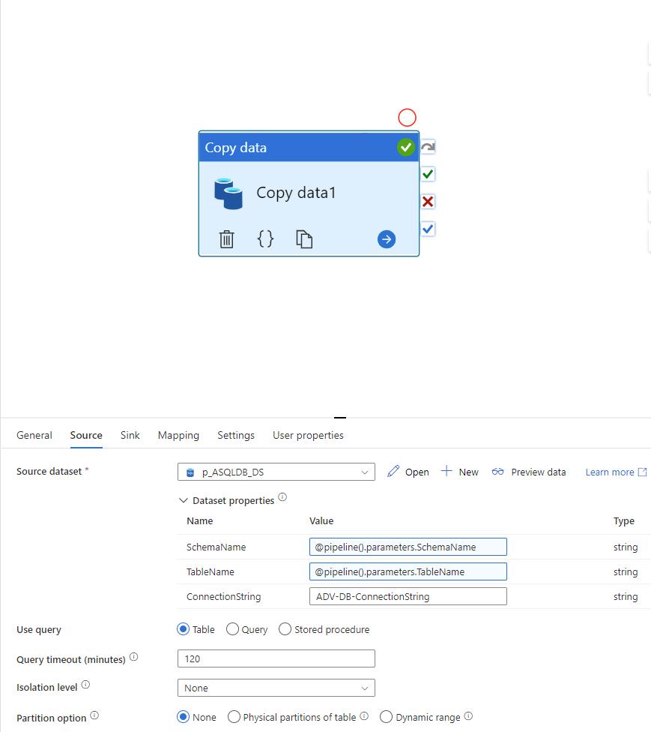
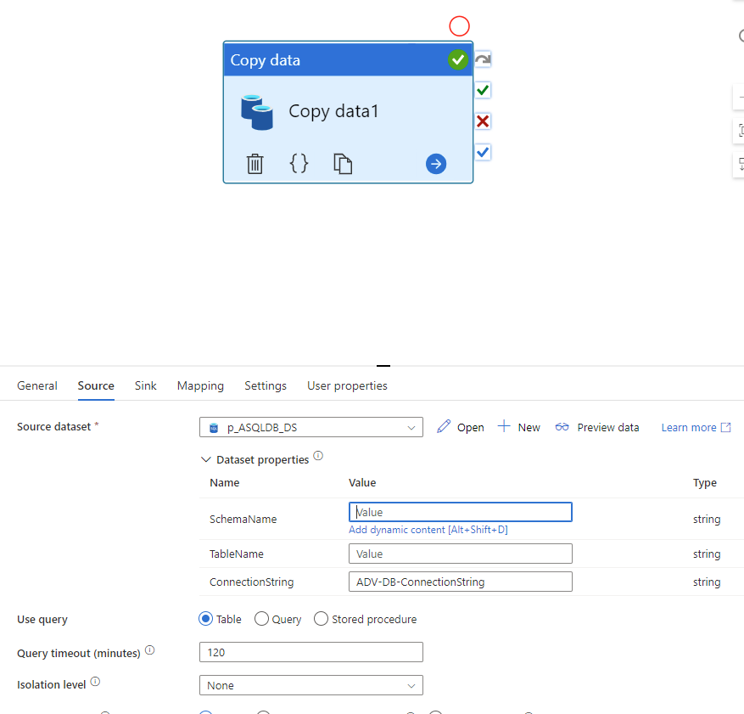
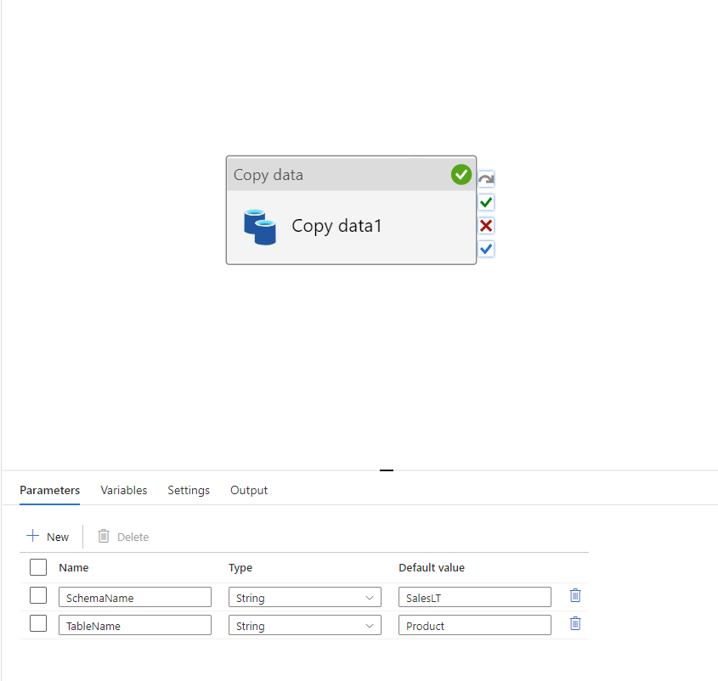
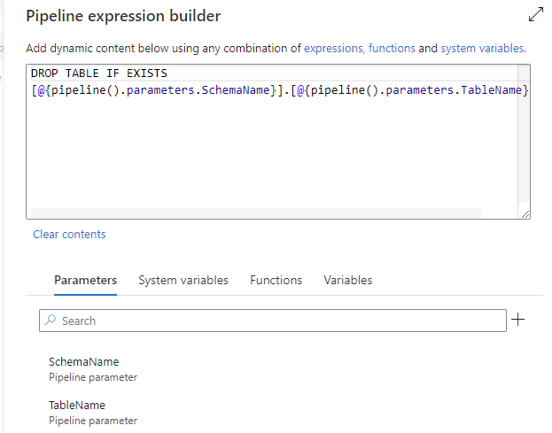
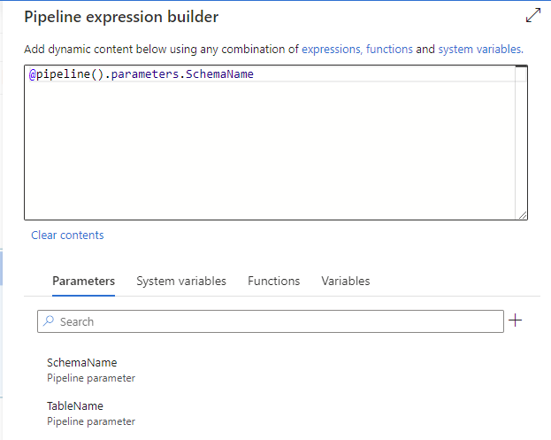
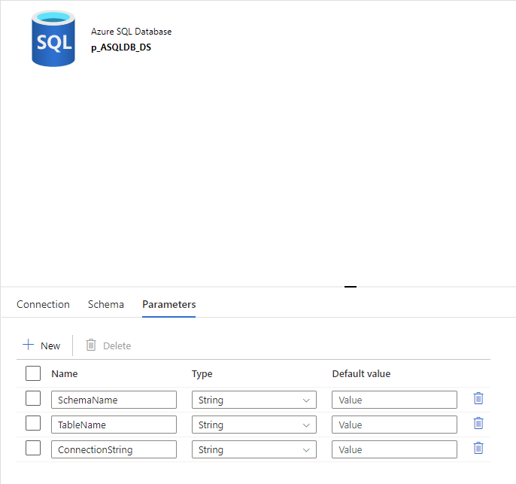
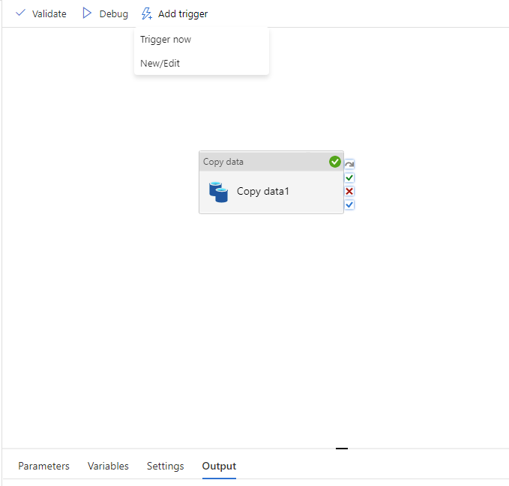
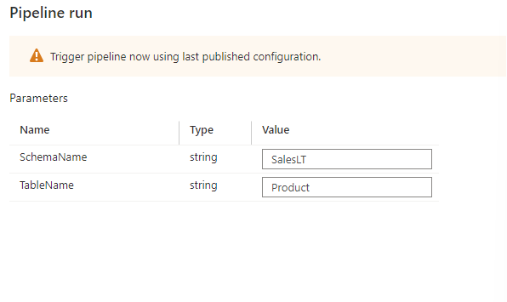
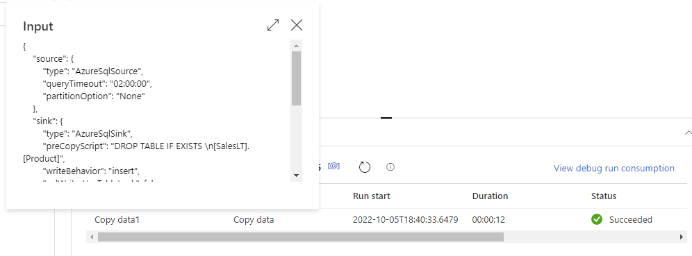
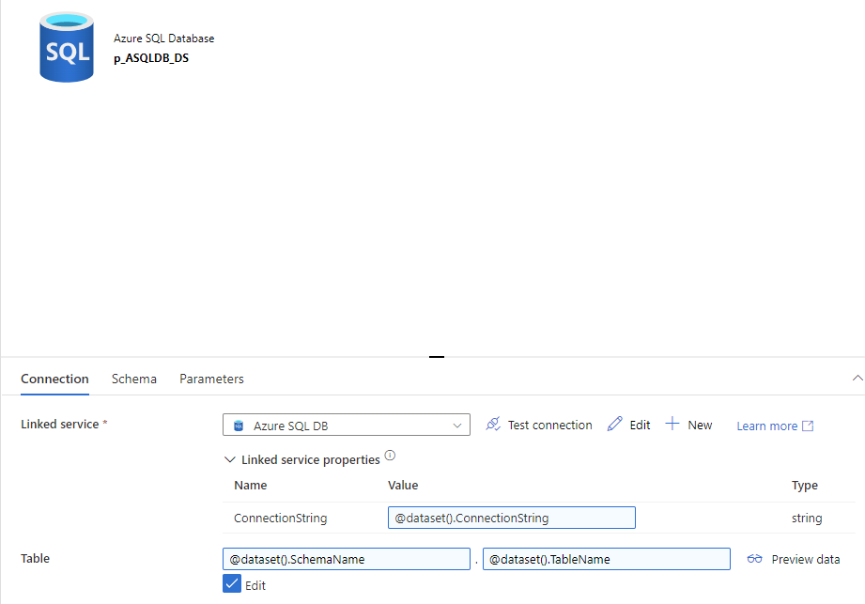
To build a parameterized pipeline
Create Linked Services with parameters
Create Data Sets with parameters
Create Pipeline with parameters
Create Activities inside pipeline with parameters and expressions
Test
Set Trigger

Slide 15
Connection String
To enable parameterization in linked service on a database level, we used a connection string that’s stored in Azure Key Vault.
Here’s an example for it:
Data Source=adventureworksserver1.database.windows.net;Initial Catalog=AdventureWorks;User ID=admin;Password=abc;Timeout=180;

Slide 16
We know how to pass parameters into pipelines now. Where do we store the parameters? How do we automate the pipelines with the parameters not just by setting up triggers?

Slide 17
Introducing Control Database

Slide 18
Control Database
Tables
Connection
ControlTable
Stored Procedure
GetTablesFromControl

Slide 19
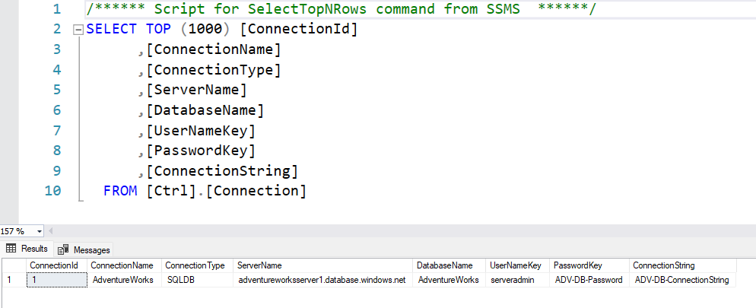
Control Database
Connection Table

Slide 20
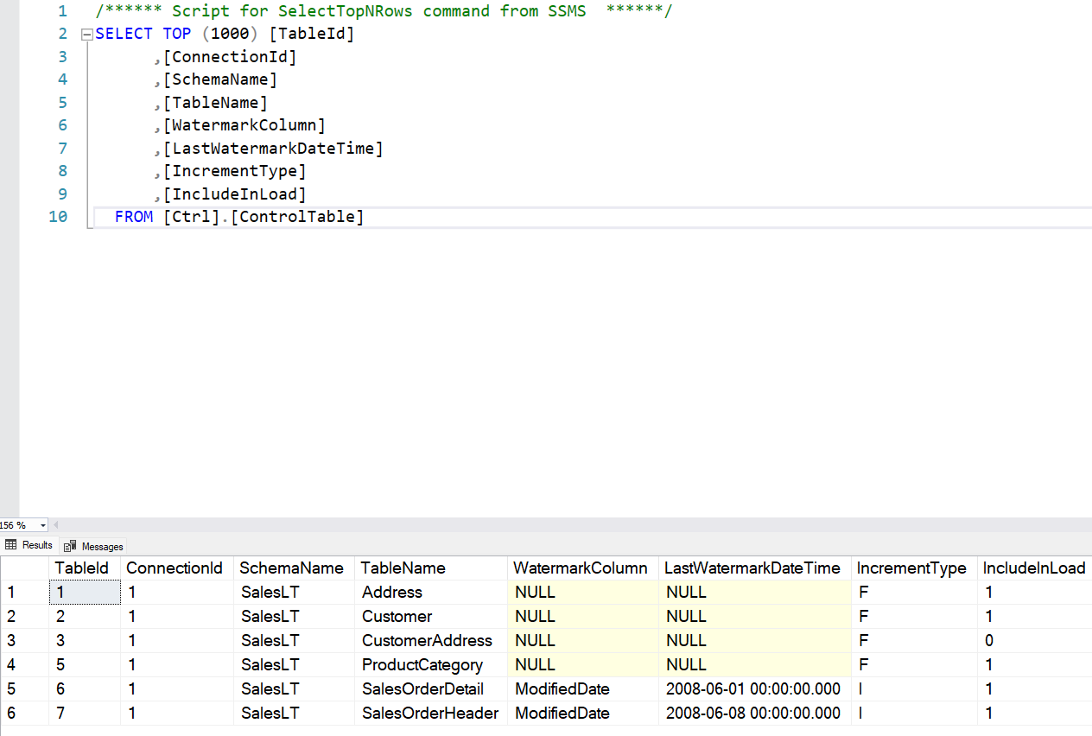
Control Database
ControlTable Table

Slide 21
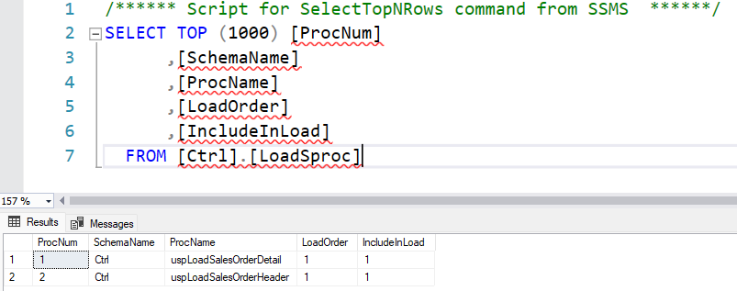
Control Database
LoadSproc Table

Slide 22
Control Database & parameterized ADF Pipeline Walkthrough

Slide 23
Question Time

Slide 24
Thank you!

